Slide 1
PROJECT TITLE
CIFAR-10 IMAGE CLASSIFICATION

Slide 2
INTRODUCTION
CIFAR-10 Dataset: CIFAR-10 is a benchmark dataset for image classification. It consists of 60,000 32x32 color images in 10 different classes.
Image Classification Task: The goal of our project is to develop a Convolutional Neural Network (CNN) model capable of accurately classifying these images into one of the following categories:
Airplane
Automobile
Bird
Cat
Deer
Dog
Frog
Horse
Truck
Ship
Objective: Our objective is to train a CNN model that can effectively learn and generalize patterns from these diverse images, achieving high accuracy in classifying them into their respective categories.

Slide 3
DATASET OVERVIEW
Content:
Training Set:
Number of Training Images: 50,000
Image Dimensions: 32 x 32 pixels
Color Channels: 3 (RGB)
Training Images Shape: [50000, 32, 32, 3]
Training Labels Shape: [50000, 1]
Test Set:
Number of Test Images: 10,000
Image Dimensions: 32 x 32 pixels
Color Channels: 3 (RGB)
Test Images Shape: [10000, 32, 32, 3]
Test Labels Shape: [10000, 1]
Notes:
The dataset is split into training and test sets, each containing images of size 32x32 pixels with three color channels.
The training set consists of 50,000 images used to train the CNN model.
The test set comprises 10,000 images used to evaluate the model's performance on unseen data.

Slide 4
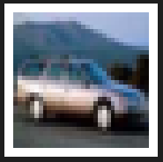
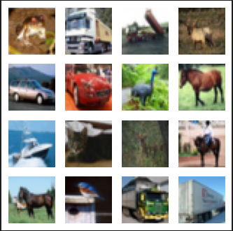
DATA VISUALIZATION
Example Image:
Display a single example image from the dataset using Matplotlib.
img = train_images[4]
plt.figure(figsize=(2,2))
plt.imshow(img, cmap=plt.cm.binary)
plt.axis("off")
plt.show()
Overview Grid:
Present a grid of 4x4 images to provide a visual summary of the dataset.
m=4
k=0
plt.figure(figsize=(4,4))
for i in range(0,m):
for j in range(0,m):
plt.subplot2grid((m,m),(i,j))
plt.imshow(train_images[k])
k=k+1
plt.axis("off")
plt.show()

Slide 5
DATA PREPROCESSING
Normalization Explanation:
Normalization is a crucial step in preparing image data for training machine learning models.
In the context of image data, pixel values typically range from 0 to 255 for each color channel (0 for black, 255 for white).
Normalization involves scaling these pixel values to a standardized range, often [0, 1], by dividing each pixel value by the maximum (255).
train_images = train_images / 255
test_images = test_images / 255
Importance of Normalization:
Ensures that pixel values are within a consistent and manageable range.
Aids in model convergence during training, preventing large weights and potential instability.
Facilitates faster training and improved model generalization.

Slide 6
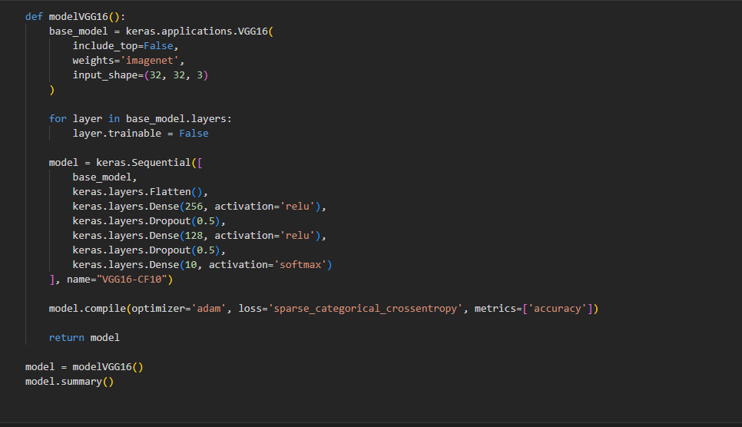

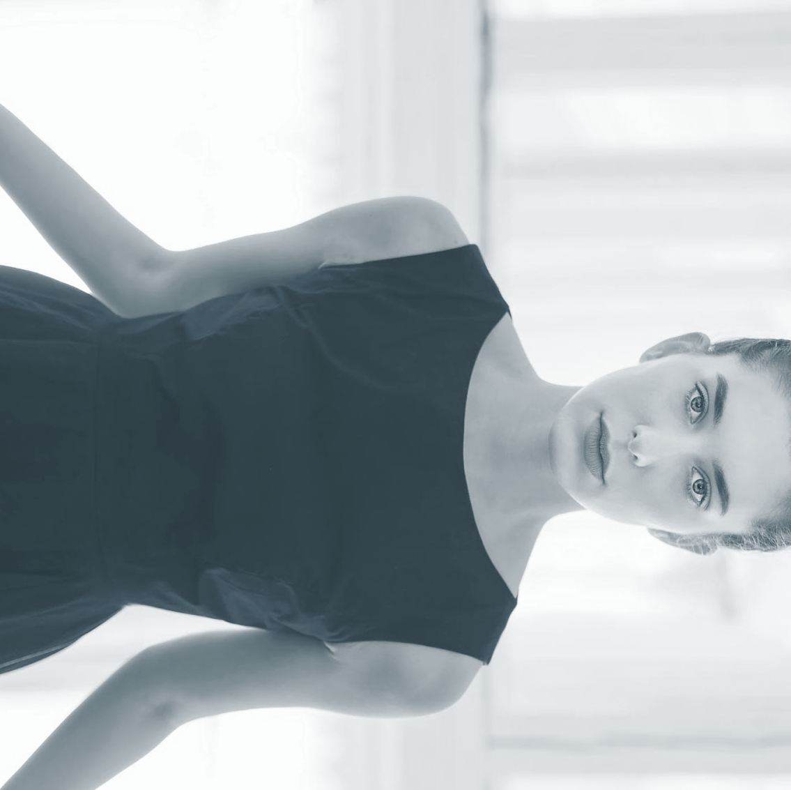

CNN ARCHITECTURE
Sequential Model in Keras:
The CNN architecture is implemented
using the Keras Sequential model,
allowing a linear stack of layers.
Key Layers:
Conv2D:
Convolutional layer for feature extraction.
MaxPooling2D:
Downsampling to retain important information.
Dropout:
Regularization to prevent overfitting.
Flatten:
Reshapes the output for input to Dense layers.
Dense:
Fully connected layers for classification.

Slide 7
MODEL TRAINING
Optimization Algorithm:
Optimizer: Adam
Adam is a popular optimization algorithm known for its efficiency in training deep neural networks.
It adapts the learning rates for each parameter individually, combining the benefits of both Adagrad and RMSProp.
Loss Function:
Loss Function: Sparse Categorical Crossentropy
Categorical Crossentropy is suitable for multiclass classification problems.
The 'sparse' variant is used when the labels are integers (like in CIFAR-10).
Training Details:
Epochs: 35
The number of times the entire dataset is processed during training.
A balance between achieving convergence and avoiding overfitting.
Batch Size: 128
The number of training examples utilized in one iteration.
Affects training speed and memory usage.

Slide 8
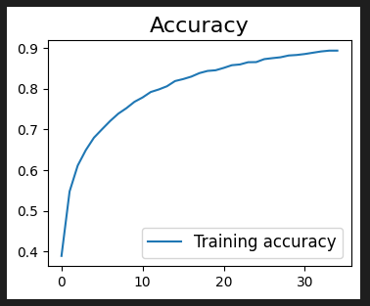
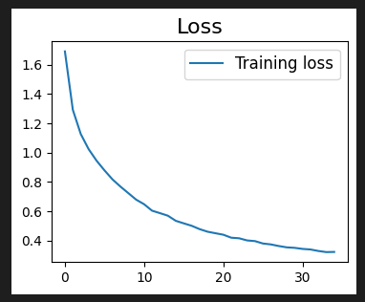
TRAINING ACCURACY AND LOSS
Training Accuracy:
Display a line plot illustrating the training accuracy over
Epochs.
accuracy = history.history['accuracy']
plt.figure(figsize=(6, 4))
plt.plot(accuracy, label='Training accuracy', marker='o')
plt.title('Training Accuracy Over Epochs', fontsize=16)
plt.xlabel('Epochs', fontsize=12)
plt.ylabel('Accuracy', fontsize=12)
plt.legend(fontsize=10)
Training Loss:
Display a line plot illustrating the training loss over epochs.
loss = history.history['loss']
plt.figure(figsize=(6, 4))
plt.plot(loss, label='Training loss', marker='o', color='orange')
plt.title('Training Loss Over Epochs', fontsize=16)
plt.xlabel('Epochs', fontsize=12)
plt.ylabel('Loss', fontsize=12)
plt.legend(fontsize=10)

Slide 9
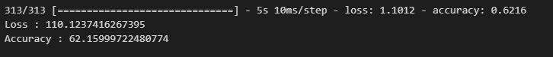
MODEL EVALUATION
Evaluation Code:
Evaluate the trained model on the test set and display the loss and accuracy.
val_loss, val_acc = model.evaluate(test_images, test_labels)
print("Test Loss: {:.2f}".format(val_loss))
print("Test Accuracy: {:.2%}".format(val_acc))
Results Display:
Present the test set accuracy and loss.

Slide 10
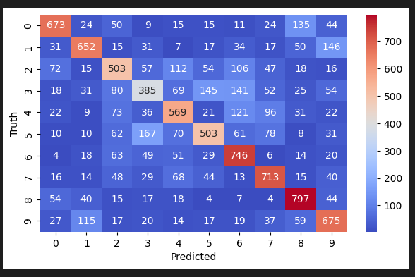
CONFUSION MATRIX
Confusion Matrix:
Utilize Seaborn's heatmap to visualize the confusion matrix.
CODE:
preds_labels = model.predict(test_images)
predicted_labels = [np.argmax(i) for i in preds_labels]
cm = tf.math.confusion_matrix(test_labels, predicted_labels)
plt.figure(figsize=(8, 6))
sns.heatmap(cm, annot=True, fmt='d', cmap='coolwarm')
plt.title('Confusion Matrix', fontsize=16)
plt.xlabel('Predicted', fontsize=12)
plt.ylabel('True', fontsize=12)

Slide 11
CONCLUSION
Achievements:
Successfully implemented a Convolutional Neural Network (CNN) for classifying CIFAR-10 images.
Achieved a training accuracy of [training accuracy] and a test accuracy of [test accuracy]% after 35 epochs.
Data Preprocessing:
Demonstrated the importance of data normalization for numerical stability and model convergence.
Model Architecture:
Described the CNN architecture, leveraging Conv2D, MaxPooling2D, Dropout, Flatten, and Dense layers.
Achieved a well-balanced model structure for feature extraction and classification.
Training Process:
Trained the model using the Adam optimizer and Sparse Categorical Crossentropy loss.
Conducted training for 35 epochs with a batch size of 128.
Evaluation and Analysis:
Evaluated the model on the test set, achieving a test accuracy of [test accuracy]% and a loss of [test loss].
Visualized the training performance through accuracy and loss plots, providing insights into model convergence.
Confusion Matrix:
Presented a confusion matrix to showcase the model's performance on individual classes.

Slide 12
Q & A
Invitation to the Audience:
"Thank you for your attention. We now invite any questions, comments, or discussions from the audience."

